Slide 1
IT 331 Project: Cookie
Jan Justyn Dela Cruz

Slide 2
Project overview: cookie
Topic: COOKIE
Javascript
DOM, JS events, XML/JSON
XMLHttpRequest
jQuery

Slide 3

Topic
My topic is about COOKIES
A fan page for those who loves cookies.
Inspire by another student by its minimalism.
Features:
Responsive Web Design
Navigation
Images
External & Internal Links
List
Table
Form
CSS
This Photo by Unknown Author is licensed under CC BY-SA

Slide 4

Javascript
Features:
Open new browser
Open a new browser when clicked the open button and a close button closes and notify when the browser is closed.
Localstorage
Display the name throughout the page
Notify to enter a username when visiting the page first time
Random images
Display random images in the Gallery page every time a user reload or visit the page
Last modified
Displayed at the bottom on every page on last modified
This Photo by Unknown Author is licensed under CC BY-SA

Slide 5
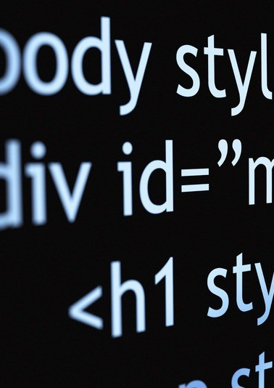
DOM, JS events, Xml/json
Features:
Remove and append content
A small quiz within the About page
A cookie clicker game within the site game.
Change style of page content
Change the background of the cookie game
Rollover
A rollover within the Contact page by hovering the image of the mascot
Scripted animation
The images enlarge when clicked on the two images in the Gallery page
JSON
The table for cookie guide uses JSON in the About page
This Photo by Unknown Author is licensed under CC BY-NC-ND

Slide 6

xmlhttprequest
XMLHttpRequest is used within the Source page
This Photo by Unknown Author is licensed under CC BY-SA

Slide 7

jquery
Features:
Effects
The table in About page toggle to show and hide the table
Datepicker
Able to select a date in the form on the Home page
Validation
Notify the user when they did not enter anything in the form at the Home page
This Photo by Unknown Author is licensed under CC BY-SA-NC

